Slide 1

MAJOR-1 PROJECT
Under the guidance of
Dr. Shaurya Gupta
Assistant Professor
Department of Informatics

Slide 2

Automated System for Sentimental Analysis of Streaming Data
Presented by:
Lakshay Vasuja(500067177)
Lakshay Sharma (500068760)
Divyansh Chandna(500068095)
Janvi Arya(500068030)

Slide 3
Introduction
Sentiment analysis is the process of detecting positive or negative sentiment in text. It’s often used by businesses to detect sentiment in social data, gauge brand reputation, and understand customers.
Big companies take decision based on data now not solely on their intuition and they are getting better results. Analysis of any kind has proven to be very useful in growth of large multinational corporations.
Companies maintain their social presence by analyzing whether the trend has a positive or a negative impact because sometimes things get viral for the wrong reasons so if the response is positive, they hop on it and use that for acquiring new customers.

Slide 4

Problem statement
Businesses nowadays analyse and hop on trends using their social media teams. Every big brand has a social media presence and they maintain that by hopping on trends that are being widely loved by public.
In this project, we try to create a general purpose twitter sentimental analysis system where a user can analyze both tweets posted by a particular user or tweets related to a specific hashtag or keyword. It will help to overcome the challenges of identifying the sentiments of the tweets.

Slide 5

Objective
The main objective is to create a general purpose twitter sentimental analysis system which will automate the process of tweets sentimental analysis in real time.
Automate the whole process.
Enhance the process of Sentimental Analysis
Save the end user time by collectively perform all the steps together rather than separately (Gathering of Data, Sentimental Analysis, Deriving useful insights about those tweets).

Slide 6
Methodology
Generating keys and tokens: For that a developer account was created which in turn will provide us with certain keys that will be used to access the tweets. Tweets will be fetched according to the needs and the input entered by the user. The input can be a twitter username and keywords or hashtag.
Fetching the Data: After that, data needs to be fetched from the twitter by passing parameter as a username, keyword or hashtag.
Pre-processing the fetched data: In this process, the fetched data is preprocessed by applying different operations such as removal of digits, lowering the text, lemmatization and tokenization.
Performing Sentimental Analysis: Sentimental analysis is performed based on three sentiments neutral, positive and negative. The tweets will be classified based on the text used in that particular tweet. A sentiment score is calculated using Naïve Bayes Analyzer and based off of those different types of tweets (positive, negative and neutral tweets) are filtered out.

Slide 7
Storing results in Data frames: The filtered-out tweets are then stored in three different data frames (positive, negative and neutral). A graph needs to be plotted but before that the percentages are calculated of the three different types of tweets using some mathematical formulas.
Visualization: Now that we have the different percentage of data we will plot it accordingly on the pie chart using python libraries like matplotlib.

Slide 8
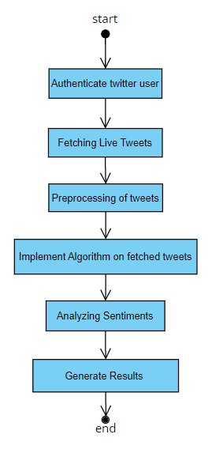
Flow Chart

Slide 9
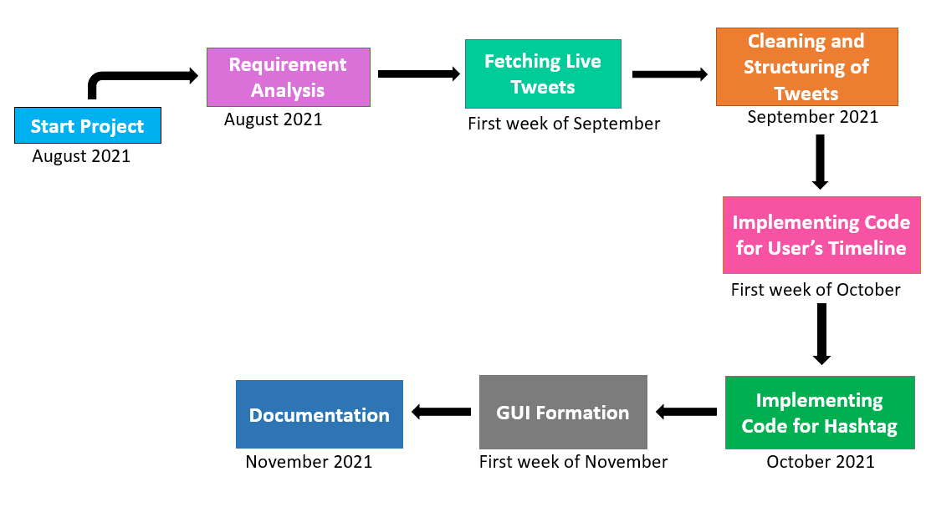
PErt chart

Slide 10
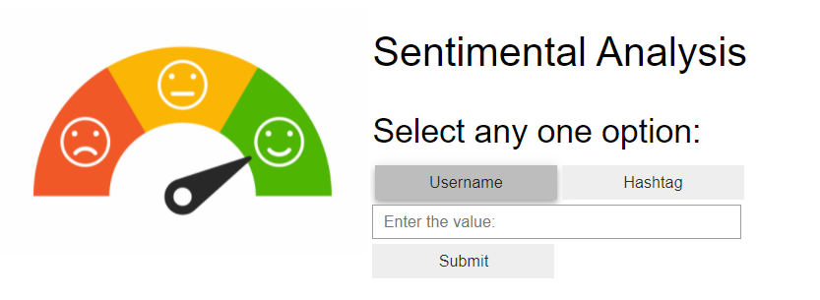
Results
GUI of our project

Slide 11
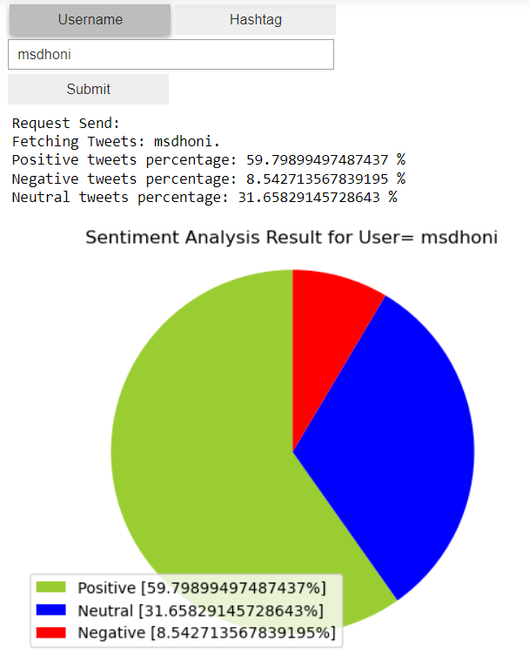
Analysis of User Tweets using username

Slide 12
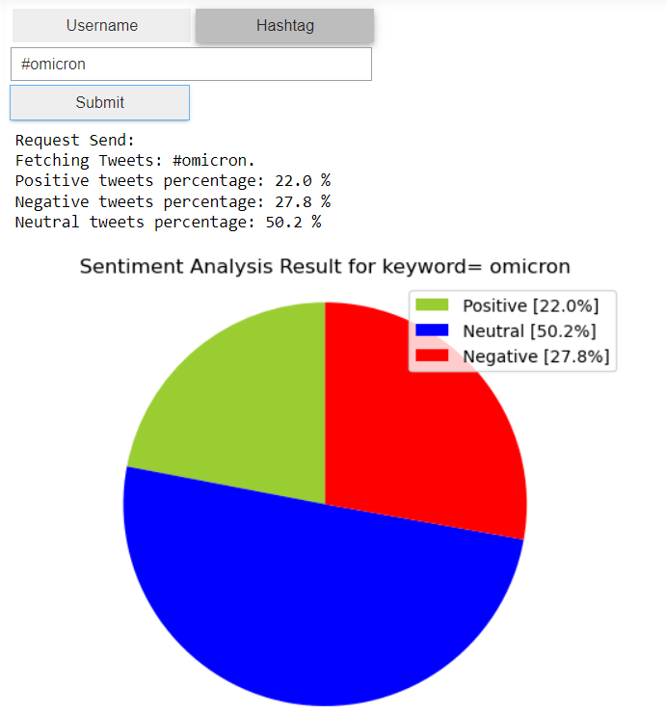
Analysis of User Tweets using hashtag

Slide 13
Reference links
Hossam ELzayady, Khaled M.Badran, Gouda I. Salama,(2018). Sentiment Analysis on Twitter Data using Apache Spark Framework, 10.1109/ICCES.2018.8639195.
Dr. Khalid N. Alhayyan & Dr. Imran Ahmad (2017). “Discovering and Analyzing Important Real-Time Trends in Noisy Twitter Stream” n.p
Shashank Gupta (2018, January 7). Sentiment Analysis: Concept, Analysis and Applications. Retrieved From: https://towardsdatascience.com/sentiment-analysis-concept-analysis-and-applications-6c94d6f58c17
Sandeep Dayananda (2019, May 22). Spark Streaming Tutorial – Sentiment Analysis Using Apache Spark. Retrieved From: https://www.edureka.co/blog/spark-streaming/
Nikhil Raj (2021, June 15). Starters Guide to Sentiment Analysis using Natural Language Processing. Retrieved From: https://www.analyticsvidhya.com/blog/2021/06/nlp-sentiment-analysis/

